Slide 1
DATA MINING LECTURE 7
Hierarchical Clustering, DBSCAN

Slide 2
CLUSTERING

Slide 3
What is a Clustering?
In general a grouping of objects such that the objects in a group (cluster) are similar (or related) to one another and different from (or unrelated to) the objects in other groups
Inter-cluster distances are maximized
Intra-cluster distances are minimized

Slide 4
Clustering Algorithms
K-means and its variants
Hierarchical clustering
DBSCAN

Slide 5
HIERARCHICAL CLUSTERING

Slide 6
Hierarchical Clustering
Two main types of hierarchical clustering
Agglomerative:
Start with the points as individual clusters
At each step, merge the closest pair of clusters until only one cluster (or k clusters) left
Divisive:
Start with one, all-inclusive cluster
At each step, split a cluster until each cluster contains a point (or there are k clusters)
Traditional hierarchical algorithms use a similarity or distance matrix
Merge or split one cluster at a time

Slide 7
Hierarchical Clustering
Produces a set of nested clusters organized as a hierarchical tree
Can be visualized as a dendrogram
A tree like diagram that records the sequences of merges or splits

Slide 8
Strengths of Hierarchical Clustering
Do not have to assume any particular number of clusters
Any desired number of clusters can be obtained by ‘cutting’ the dendogram at the proper level

Slide 9
Agglomerative Clustering Algorithm
More popular hierarchical clustering technique
Basic algorithm is straightforward
Compute the proximity matrix
Let each data point be a cluster
Repeat
Merge the two closest clusters
Update the proximity matrix
Until only a single cluster remains
Key operation is the computation of the proximity of two clusters
Different approaches to defining the distance between clusters distinguish the different algorithms

Slide 10
Starting Situation
Start with clusters of individual points and a proximity matrix
p1
p2
p3
p4
p5
. . .
p1
p2
p3
p4
p5
.
.
.
Proximity Matrix

Slide 11
Intermediate Situation
After some merging steps, we have some clusters
C1
C2
C3
C4
C5
C1
C2
C3
C3
C4
C4
C5
C1
Proximity Matrix
C2
C5

Slide 12
Intermediate Situation
We want to merge the two closest clusters (C2 and C5) and update the proximity matrix.
C1
C2
C3
C4
C5
C1
C2
C3
C3
C4
C4
C5
Proximity Matrix
C1
C2
C5

Slide 13
After Merging
The question is “How do we update the proximity matrix?”
C2 U C5
C1
C3
C4
C1
?
C2 U C5
? ? ? ?
C3
C3
?
C4
C4
?
C1
Proximity Matrix
C2 U C5

Slide 14
How to Define Inter-Cluster Similarity
p1
p2
p3
p4
p5
. . .
p1
Similarity?
p2
p3
p4
p5
MIN
MAX
Group Average
Distance Between Centroids
Other methods driven by an objective function
Ward’s Method uses squared error
.
.
.
Proximity Matrix

Slide 15
How to Define Inter-Cluster Similarity
p1
p2
p3
p4
p5
. . .
p1
p2
p3
p4
p5
MIN
MAX
Group Average
Distance Between Centroids
Other methods driven by an objective function
Ward’s Method uses squared error
.
.
.
Proximity Matrix

Slide 16
How to Define Inter-Cluster Similarity
p1
p2
p3
p4
p5
. . .
p1
p2
p3
p4
p5
MIN
MAX
Group Average
Distance Between Centroids
Other methods driven by an objective function
Ward’s Method uses squared error
.
.
.
Proximity Matrix

Slide 17
How to Define Inter-Cluster Similarity
p1
p2
p3
p4
p5
. . .
p1
p2
p3
p4
p5
MIN
MAX
Group Average
Distance Between Centroids
Other methods driven by an objective function
Ward’s Method uses squared error
.
.
.
Proximity Matrix

Slide 18
How to Define Inter-Cluster Similarity
p1
p2
p3
p4
p5
. . .
p1
×
×
p2
p3
p4
p5
MIN
MAX
Group Average
Distance Between Centroids
Other methods driven by an objective function
Ward’s Method uses squared error
.
.
.
Proximity Matrix

Slide 19
Single Link – Complete Link
Another way to view the processing of the hierarchical algorithm is that we create links between their elements in order of increasing distance
The MIN – Single Link, will merge two clusters when a single pair of elements is linked
The MAX – Complete Linkage will merge two clusters when all pairs of elements have been linked.

Slide 20
Hierarchical Clustering: MIN
 | 1 | 2 | 3 | 4 | 5 | 6
1 | 0 | .24 | .22 | .37 | .34 | .23
2 | .24 | 0 | .15 | .20 | .14 | .25
3 | .22 | .15 | 0 | .15 | .28 | .11
4 | .37 | .20 | .15 | 0 | .29 | .22
5 | .34 | .14 | .28 | .29 | 0 | .39
6 | .23 | .25 | .11 | .22 | .39 | 0
5
1
3
5
2
1
2
3
6
4
4
Nested Clusters
Dendrogram

Slide 21
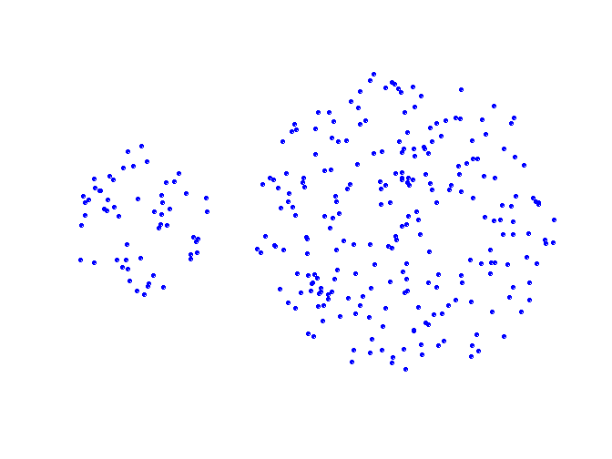
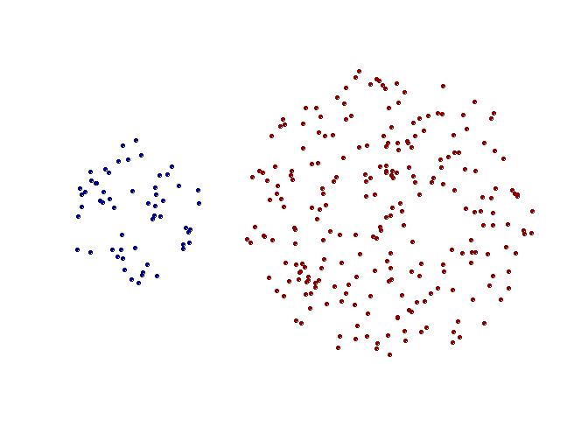
Strength of MIN
Original Points
Two Clusters
Can handle elliptical shapes

Slide 22
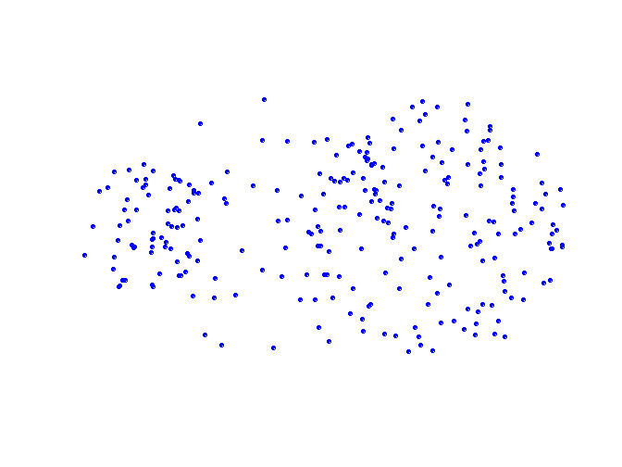
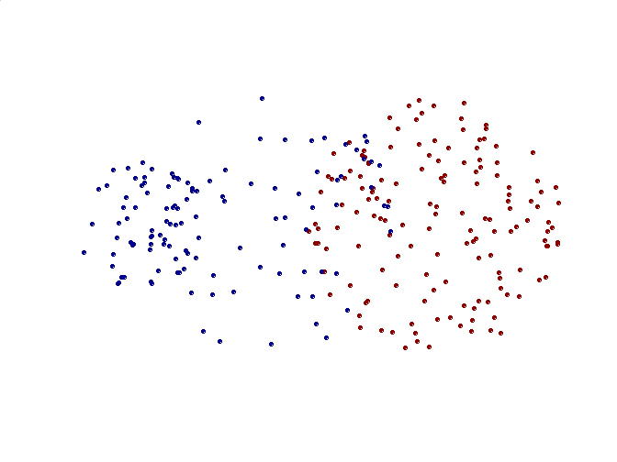
Limitations of MIN
Original Points
Two Clusters
Sensitive to noise and outliers

Slide 23
Hierarchical Clustering: MAX
 | 1 | 2 | 3 | 4 | 5 | 6
1 | 0 | .24 | .22 | .37 | .34 | .23
2 | .24 | 0 | .15 | .20 | .14 | .25
3 | .22 | .15 | 0 | .15 | .28 | .11
4 | .37 | .20 | .15 | 0 | .29 | .22
5 | .34 | .14 | .28 | .29 | 0 | .39
6 | .23 | .25 | .11 | .22 | .39 | 0
4
1
2
5
5
2
3
6
3
1
4
Nested Clusters
Dendrogram

Slide 24
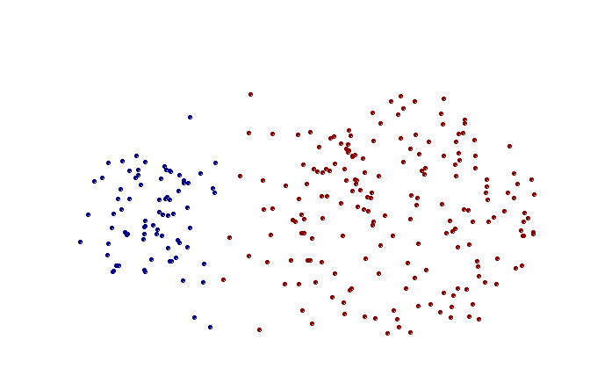
Strength of MAX
Original Points
Two Clusters
Less susceptible to noise and outliers

Slide 25
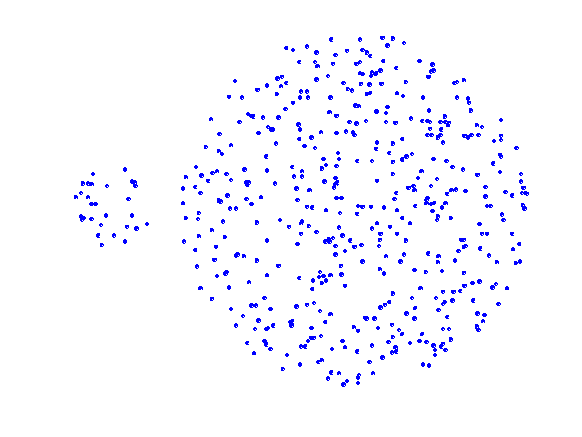
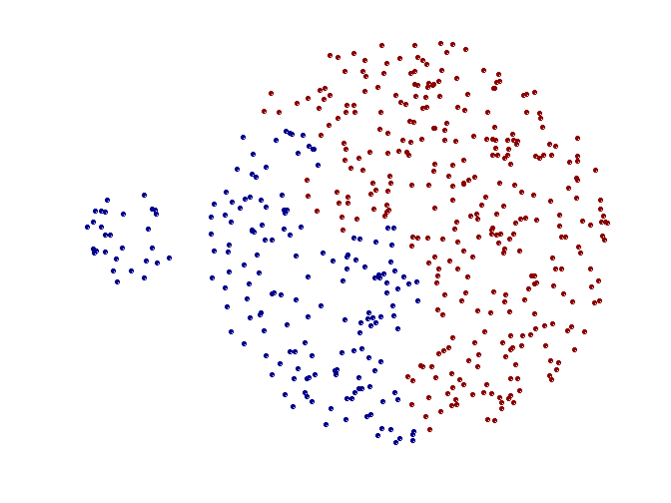
Limitations of MAX
Original Points
Two Clusters
Tends to break large clusters
Biased towards globular clusters

Slide 26
Cluster Similarity: Group Average
Proximity of two clusters is the average of pairwise proximity between points in the two clusters.
 | 1 | 2 | 3 | 4 | 5 | 6
1 | 0 | .24 | .22 | .37 | .34 | .23
2 | .24 | 0 | .15 | .20 | .14 | .25
3 | .22 | .15 | 0 | .15 | .28 | .11
4 | .37 | .20 | .15 | 0 | .29 | .22
5 | .34 | .14 | .28 | .29 | 0 | .39
6 | .23 | .25 | .11 | .22 | .39 | 0

Slide 27
Hierarchical Clustering: Group Average
 | 1 | 2 | 3 | 4 | 5 | 6
1 | 0 | .24 | .22 | .37 | .34 | .23
2 | .24 | 0 | .15 | .20 | .14 | .25
3 | .22 | .15 | 0 | .15 | .28 | .11
4 | .37 | .20 | .15 | 0 | .29 | .22
5 | .34 | .14 | .28 | .29 | 0 | .39
6 | .23 | .25 | .11 | .22 | .39 | 0
5
4
1
2
5
2
3
6
1
4
3
Nested Clusters
Dendrogram

Slide 28
Hierarchical Clustering: Group Average
Compromise between Single and Complete Link
Strengths
Less susceptible to noise and outliers
Limitations
Biased towards globular clusters

Slide 29
Cluster Similarity: Ward’s Method
Similarity of two clusters is based on the increase in squared error (SSE) when two clusters are merged
Similar to group average if distance between points is distance squared
Less susceptible to noise and outliers
Biased towards globular clusters

Slide 30
Hierarchical Clustering: Comparison
5
1
4
1
3
2
5
5
5
2
1
MIN
2
MAX
2
3
6
3
3
6
1
4
4
4
5
5
1
4
1
2
2
5
2
Ward’s Method
5
2
3
6
Group Average
3
3
6
4
1
1
4
4
3

Slide 31
Hierarchical Clustering: Time and Space requirements
O(N²) space since it uses the proximity matrix.
N is the number of points.
O(N³) time in many cases
There are N steps and at each step the size, N², proximity matrix must be updated and searched
Complexity can be reduced to O(N² log(N) ) time for some approaches

Slide 32
Hierarchical Clustering: Problems and Limitations
Computational complexity in time and space
No objective function is directly minimized
Different schemes have problems with one or more of the following:
Sensitivity to noise and outliers
Difficulty handling different sized clusters and convex shapes

Slide 33
DBSCAN

Slide 34
DBSCAN: Density-Based Clustering
DBSCAN is a Density-Based Clustering algorithm
Reminder: In density based clustering we partition points into dense regions separated by not-so-dense regions.
Important Questions:
How do we measure density?
What is a dense region?
DBSCAN:
Density at point p: number of points within a circle of radius Eps
Dense Region: A circle of radius Eps that contains at least MinPts points

Slide 35
DBSCAN
Characterization of points
A point is a core point if it has more than a specified number of points (MinPts) within Eps
These points belong in a dense region and are at the interior of a cluster
A border point has fewer than MinPts within Eps, but is in the neighborhood of a core point.
A noise point is any point that is not a core point or a border point.

Slide 36
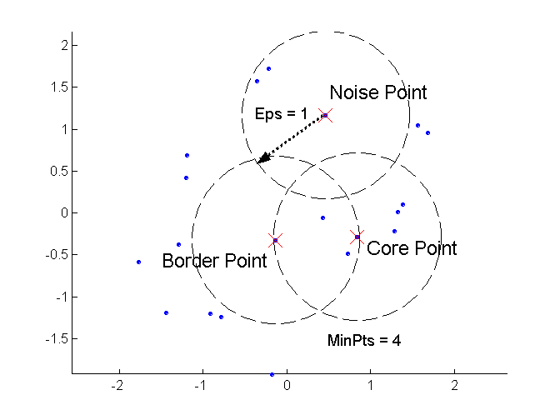
DBSCAN: Core, Border, and Noise Points

Slide 37
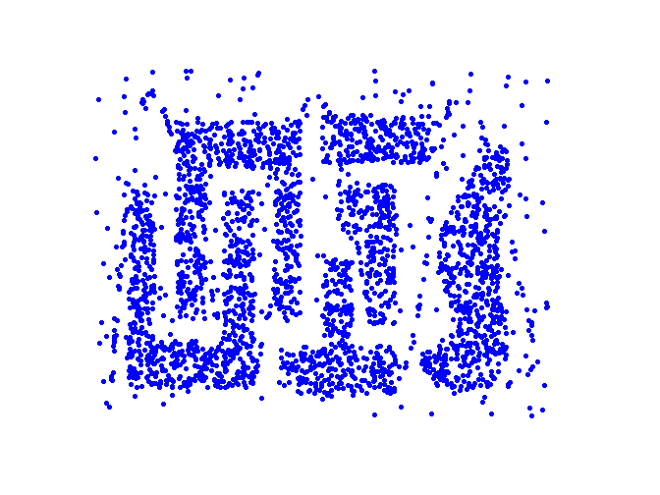
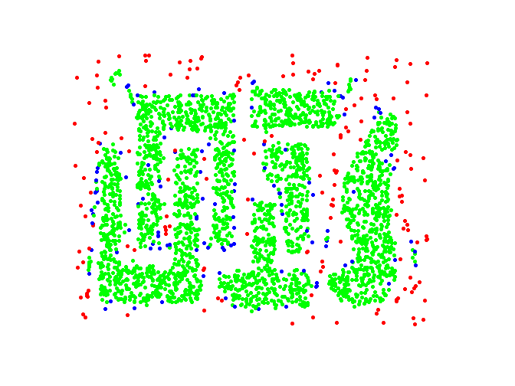
DBSCAN: Core, Border and Noise Points
Point types: core, border and noise
Original Points
Eps = 10, MinPts = 4

Slide 38
Density-Connected points
Density edge
We place an edge between two core points q and p if they are within distance Eps.
Density-connected
A point p is density-connected to a point q if there is a path of edges from p to q
p
p₁
q
p
q
o

Slide 39
DBSCAN Algorithm
Label points as core, border and noise
Eliminate noise points
For every core point p that has not been assigned to a cluster
Create a new cluster with the point p and all the points that are density-connected to p.
Assign border points to the cluster of the closest core point.

Slide 40
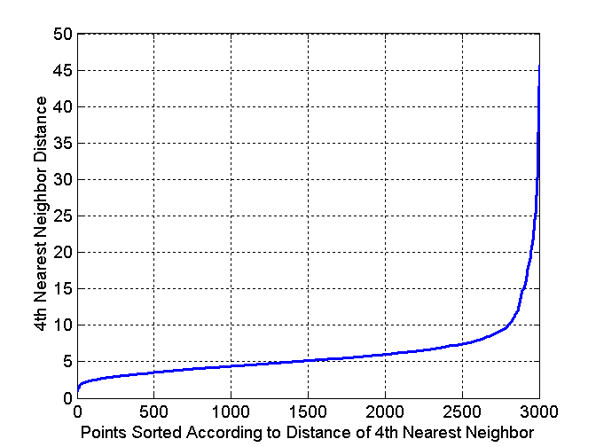
DBSCAN: Determining Eps and MinPts
Idea is that for points in a cluster, their k^{th} nearest neighbors are at roughly the same distance
Noise points have the k^{th} nearest neighbor at farther distance
So, plot sorted distance of every point to its k^{th} nearest neighbor
Find the distance d where there is a “knee” in the curve
Eps = d, MinPts = k
Eps ~ 7-10
MinPts = 4

Slide 41
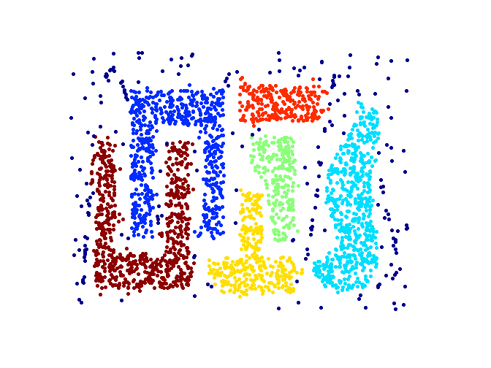
When DBSCAN Works Well
Original Points
Clusters
Resistant to Noise
Can handle clusters of different shapes and sizes

Slide 42
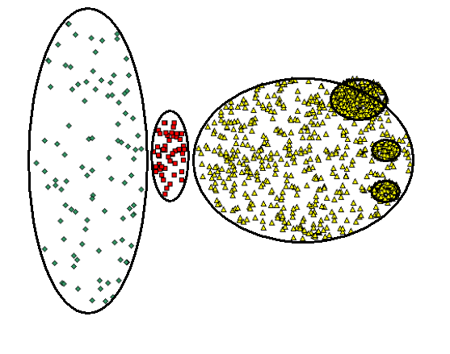
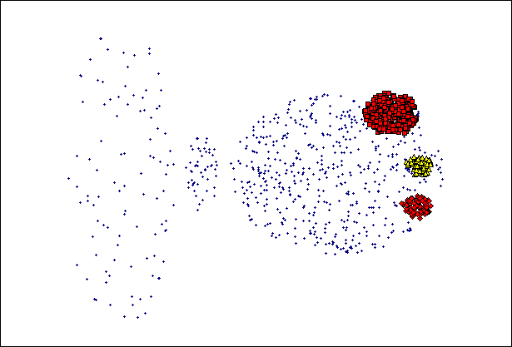
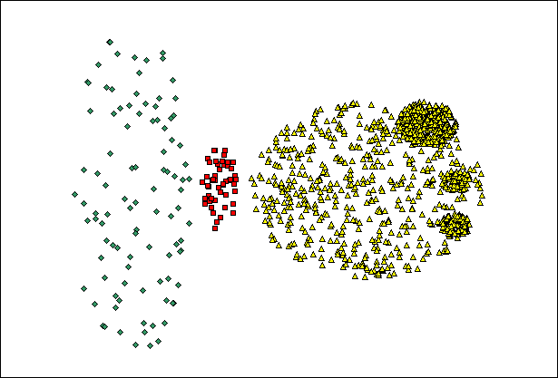
When DBSCAN Does NOT Work Well
(MinPts=4, Eps=9.75).
Original Points
Varying densities
High-dimensional data
(MinPts=4, Eps=9.92)

Slide 43
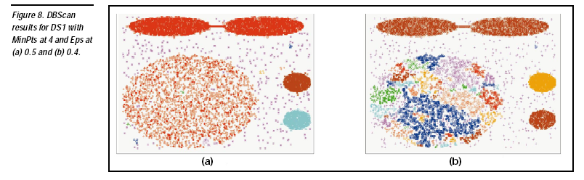

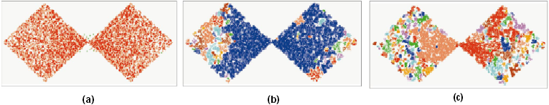
DBSCAN: Sensitive to Parameters

Slide 44
Other algorithms
PAM, CLARANS: Solutions for the k-medoids problem
BIRCH: Constructs a hierarchical tree that acts a summary of the data, and then clusters the leaves.
MST: Clustering using the Minimum Spanning Tree.
ROCK: clustering categorical data by neighbor and link analysis
LIMBO, COOLCAT: Clustering categorical data using information theoretic tools.
CURE: Hierarchical algorithm uses different representation of the cluster
CHAMELEON: Hierarchical algorithm uses closeness and interconnectivity for merging

